Slide 1
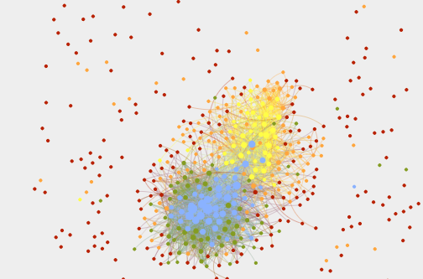


#teachertweets:
This is what democracy
looks like
@DorisASantoro
Stephen Houser
Clare Bates Congdon
@JessicaHochman
Bridget Gavlin
AERA | Washington DC, 2016 | #AERADeweyToday
Notes:
DORIS

Slide 2


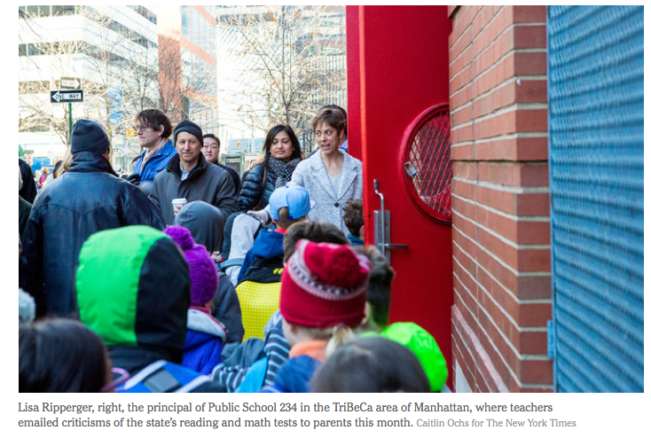
Notes:
DORIS Context: MaryEllen Elia quote that says that teachers are unethical if they support optout [I think we just keep this in notes.] (another slide or same?) We should talk to Terri about presentation order.
Might add one other slide to show problem. New York State Commissioner of
Education MaryEllen Elia said that it was “unethical” for teachers to support or encourage
students to opt-out from standardized testing. (John Hildebrand, “NY Education Commissioner Says Opt-Outs ‘Not Reasonable,’”
Newsday, August 20, 2015, http://www.newsday.com/long-island/maryellen-elia-nyeducation-
commissioner-says-test-opt-outs-not-reasonable-1.10759569.)

Slide 3
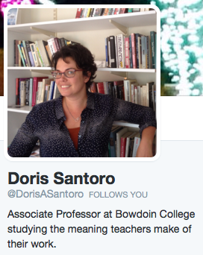


Why Twitter?
Q: Who are your activist allies?
A: They’re all on Twitter.
Notes:
DORIS Context

Slide 4
Research Questions
What categories of topics and ideas are teachers discussing on Twitter?
Are teachers making moral claims about their work on Twitter?
Are teachers developing community on Twitter, per Dewey?
How can teachers’ use of Twitter be read through Dewey’s joint concepts of democracy and education?
What are some challenges to democratic discussion on Twitter?
Notes:
JH

Slide 5
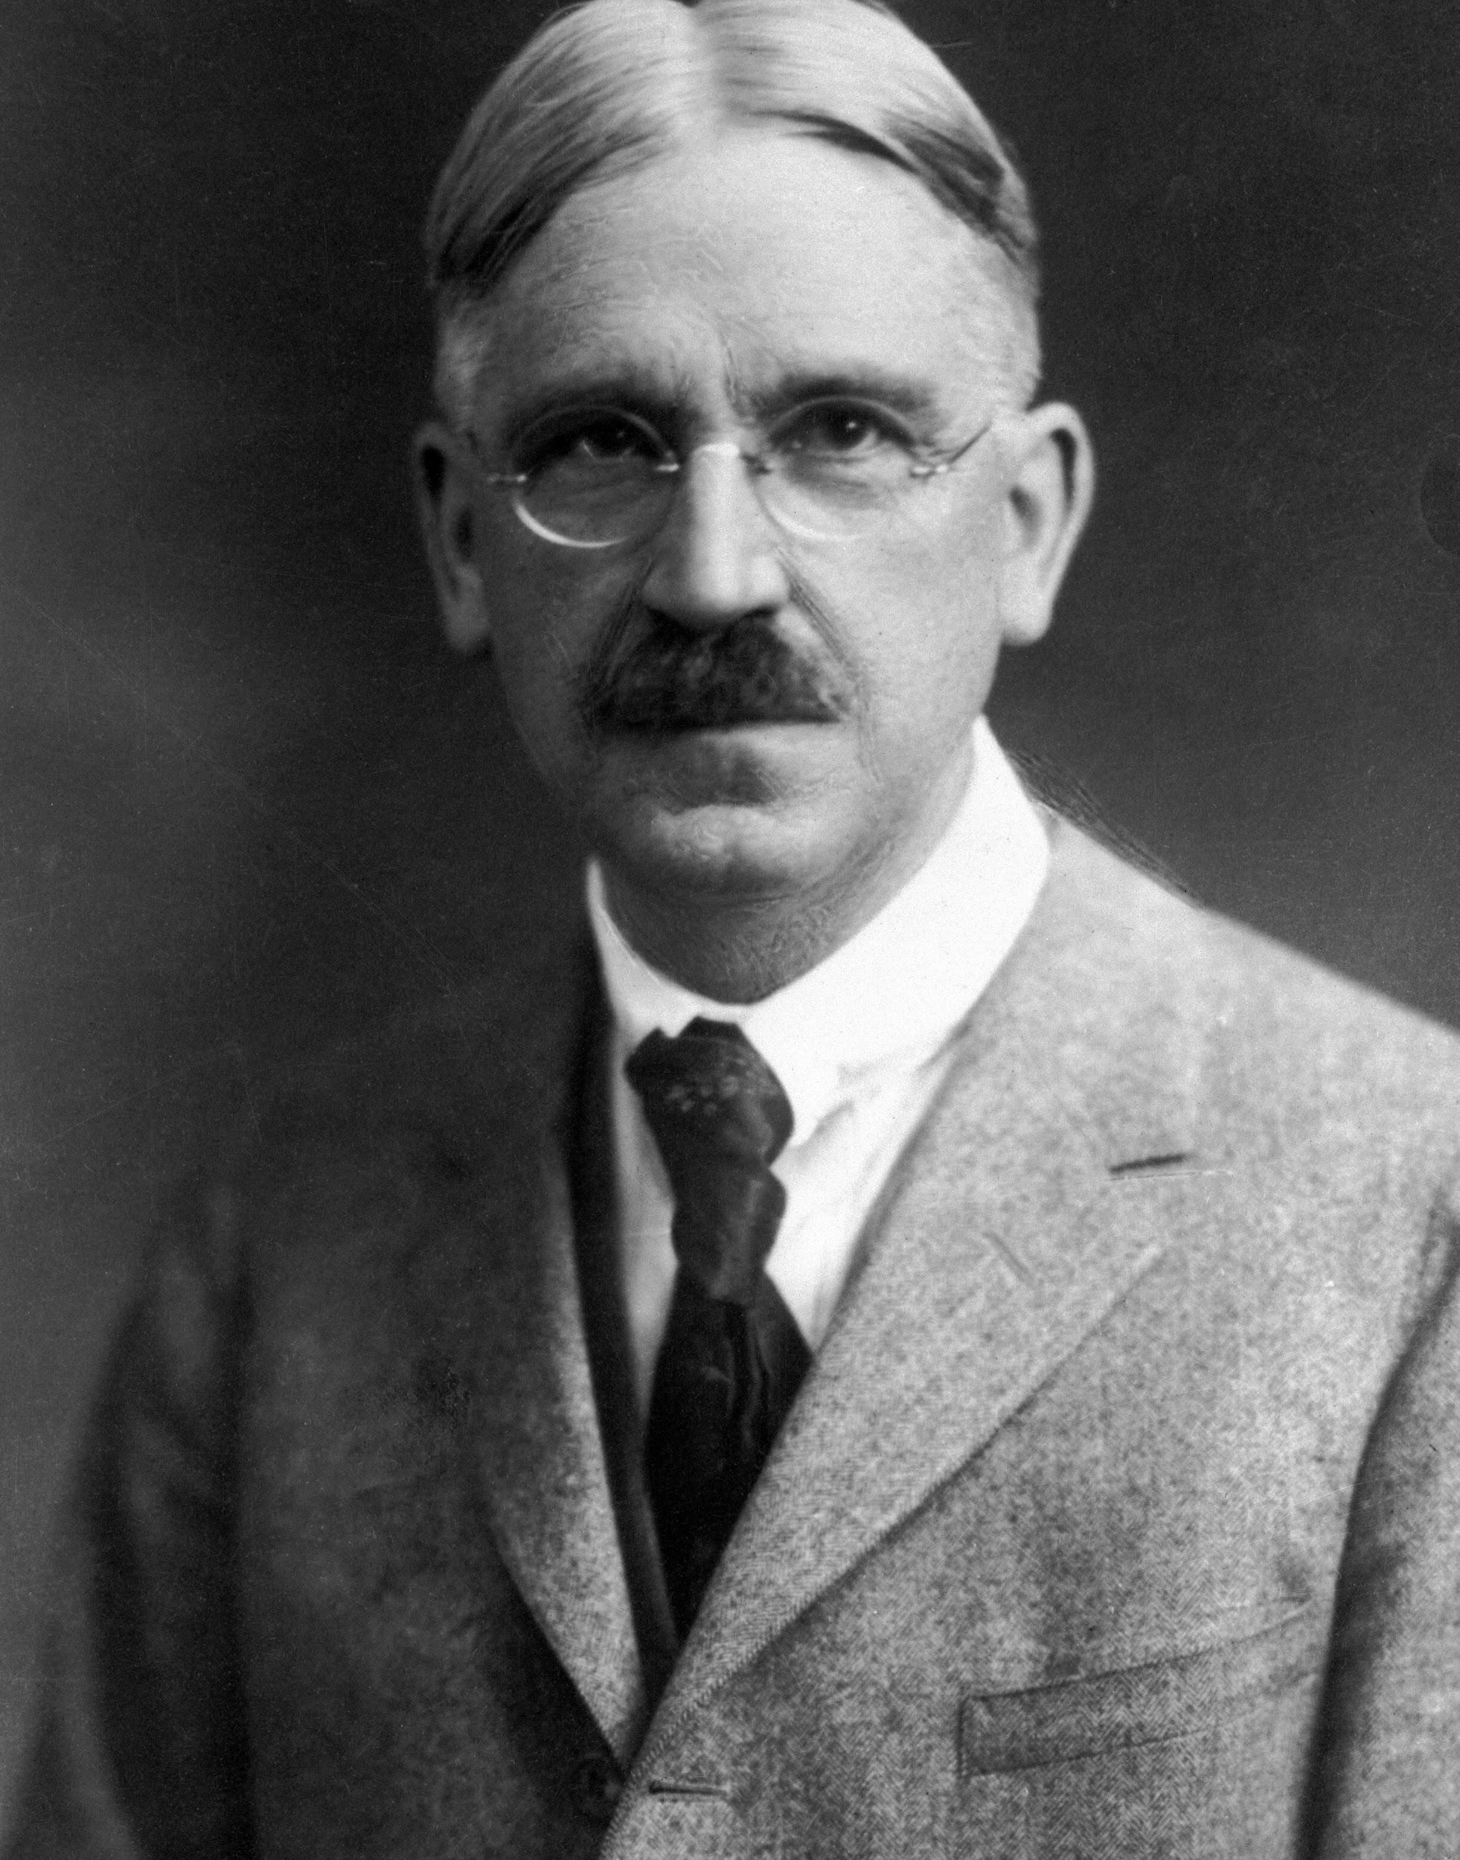

Twitter as Community
Communities develop by sharing common interests & purposes.
Shared language & meaning are paradigmatic indications of communities.
Communication creates & binds communities.
Homophily: people in communities share traits and values (Kadushin, 2011; Murthy, 2013).
Interplay of egoistic and communal tweets make Twitter interesting (Murthy, 2013).
Importance of strong
and weak ties.
Notes:
JLH: Our three Deweyan lenses: These next few slides will contextualize our data within the theoretical framework we’re using: CS, communications and network theory to explore community, democracy & teacher intelligence as they present in our data. The issue of shared language provides credence for our “words of interest” methodology. We see that communities/clusters in our dataset are formed through the shared use (or non-use) of particular words. (toptenz.net Dewey photo credit, Google Play Android twitter app)

Slide 6
Twitter as Democratic Space
Dewey Asks:
How numerous and varied are the interests which are consciously shared?
How full and free is the interplay with other forms of association?
Twitter is social and user-driven (Gruzd, Wellman & Takhteyev 2011).
Teachers often describe it as a place of “dialogue” (Brenneman, 2015; Sawchuck, 2015) and “connection” (Lu, 2011; Rami, 2012).
Twitter as “megaphone”
(Murthy, 2013).
Notes:
JH Full and free interplay = how many contact points, and how often? different societies aren’t insular (ie, our clusters interact). Fagin’s band of thieves as an example. Important to challenge the notion of echo chamber and homophily (see cambridge bib for cite on debunking echo chamber)
-democracy – Arab Spring, calls this winter on Twitter for #teacherspring; voice and organization of those not currently holding political power.
“The vice of externally imposed ends has deep roots. Teachers receive them from superior authorities; these authorities accept them from what is current in the community. The teachers impose them upon children. As a first consequence, the intelligence of the teacher is not free; it is confined to receiving the aims laid down from above. (DE, 115–16)

Slide 7
Teacher Intelligence on Twitter
In democracies, all individuals express their intelligence.
In democratic communities people understand the meaning of their work in relation to social aims.
Judgments about one’s work are expressions of intelligence.
Teachers use Twitter for professional development and to create PLN’s (Carpenter & Krutka, 2014).
“Big Data” studies centered around hashtags, i.e., #commoncore and #blacklives matter.
We explore the moral
claims of teachers.
Notes:
DORIS - In democracies, all individuals express their intelligence. This intelligence benefits not only the individual, but society as a whole, as an aggregate of individual intelligence. These are analyzed for social usefulness. Judgments about one’s work are expressions of intelligence, and often these judgments are moral. research on PLN on Twitter focuses on individual; or on specific outcomes of a non-teacher-directed program.
builds teacher intelligence; a forum for teacher intelligence; a display of teacher intelligence; making teacher intelligence public in the context of popular discourse of teacher bashing.
While Dewey was concerned about any restriction of intelligence, based on race, class, etc., he was particularly concerned about the constrained intelligence of teachers: “The vice of externally imposed ends has deep roots. Teachers receive them from
superior authorities; these authorities accept them from what is current in the community. The teachers impose them upon children. As a first consequence, the intelligence of the teacher is not free; it is confined to receiving the aims laid down from above.” (DE, 115–16)

Slide 8
Methodology by the Numbers
Pilot study
2000 tweets from 100 educator accounts
2 Instruments Developed:
Qualitative codebook
Words of Interest list
#teachertweets project
507 self-identified teacher accounts
550,508 tweets collected
4,335,085 non-stop words
10,000 trials in Autoclass
5 clusters generated
1 fingerprint
Gephi & Tableau used for visualizations
Notes:
Jessica show words of interest.

Slide 9
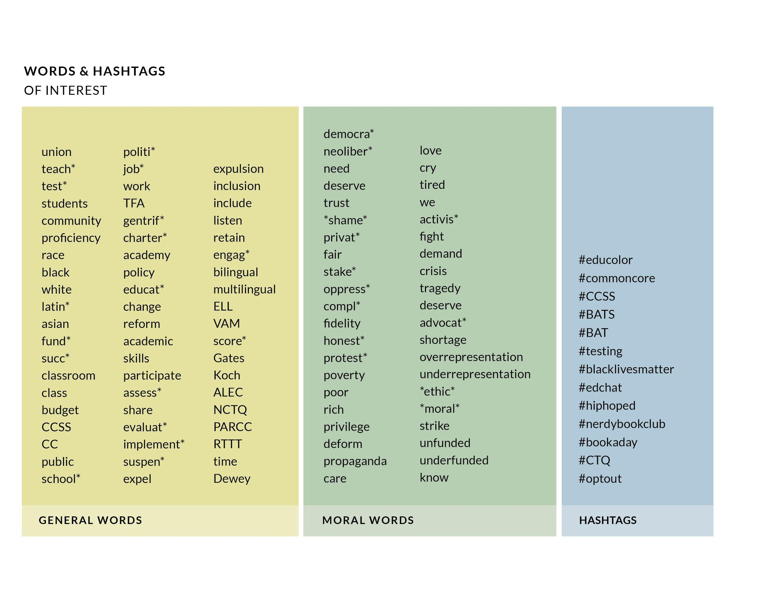
Notes:
DS Developed through analysis of 2000 tweets in pilot project and our own questions generated by participation in Twitter/research on teacher communities. The asterisks indicate that these are strings, not words.

Slide 10
Methodology: Inquiry Across Discourses
Community Intelligence Democracy Moral
BIG DATA
Notes:
JLH: This is a transdiciplinary project, that includes computer science, information science, and philosophical methods. All approach inquiry in a different way and use different discourses and instruments to answer questions. One of the challenges of this work has been working across disciplines and translating our questions back and forth between various discourses. Philosophy is particularly good at asking questions related to the ethical and moral dimensions of education and educational research. We think this perspective can be really useful when combined with a comp sci approach which is particularly well suited for dealing with big data. Our main lens is philosophical for this presentation; we use other lenses in other spaces. So, our discussion of Deweyian democracy is very similar to discussions of networks in comp sci or info sci Riff quickly on democratic aspects of collaborating across disciplines. Needed to find a common language to work together. In making CS available to other disciplines and comprehensible and applicable to the general audience, this itself is democratic in Dewey’s view.

Slide 11
Findings

Slide 12
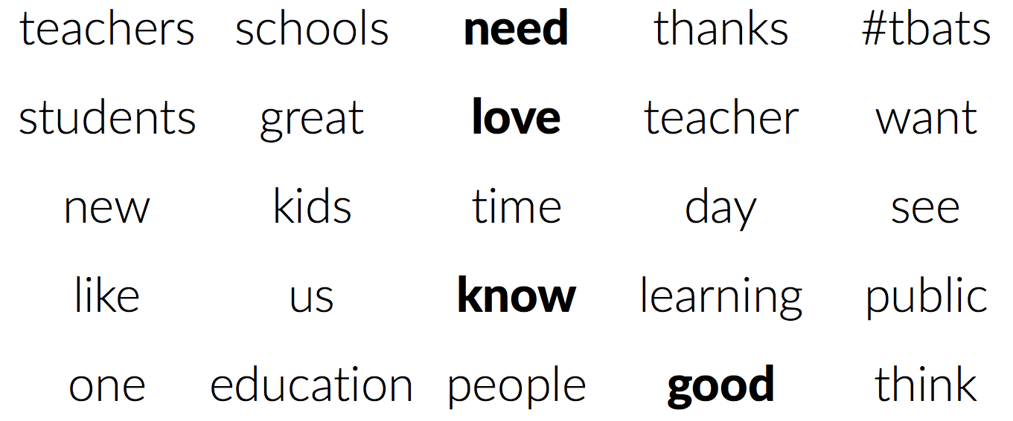
#teachertweets are about teaching
Notes:
DORIS Just in case you were wondering, teachers are tweeting about teaching! The first two words are teacher and student. Teachers are talking about their work a lot, when they could be live tweeting Walking Dead like the rest of us. Actually, there is a lot of political discourse on Twitter, but one important question to ask of Twitter networks is whether this is true dialogue in a Deweyian sense, or whether it is just an echo chamber of like-minded folks. Part of our work with this project was to look into that issue.

Slide 13
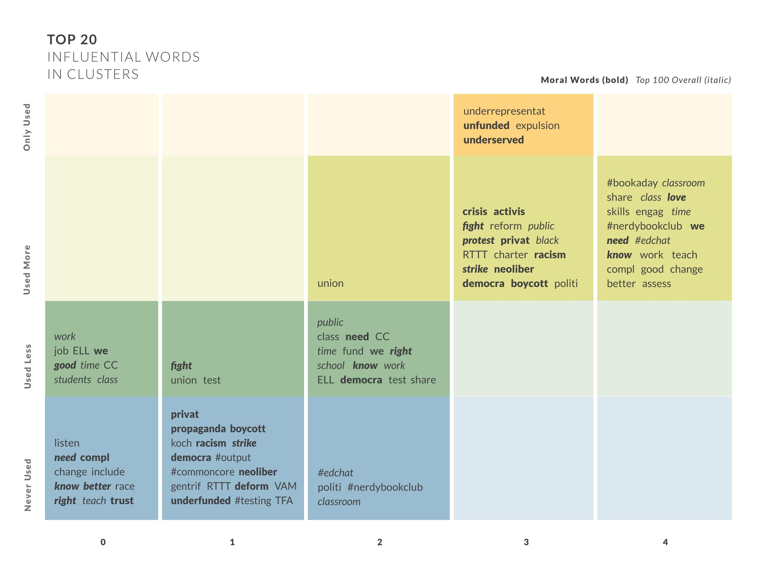
Notes:
DORIS Characterize each cluster; you can see that clusters 0-1 were shaped by words that accounts weren’t using, and 2 is shaped by both words used and not used. Then, 3 & 4 are shaped foremost by used words. Deweyans will be heartened to know that “Dewey” was an influential word due to higher than average use in Clusters 3 & 4. Kinds of words, moral words, and context; we would like to read some of these tweets at some point. Our dream is to do a deep dive into this data. We’re clearly missing meaning/significance due to decontextualization. Yet, when you see the network visualizations, these clusters really become dynamic and meaningful.

Slide 14
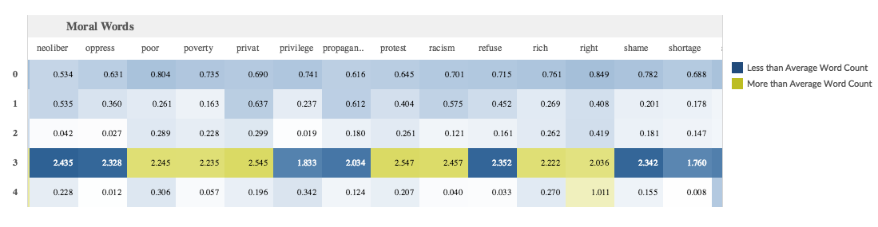
Influence Summary (Moral Words)

Slide 15
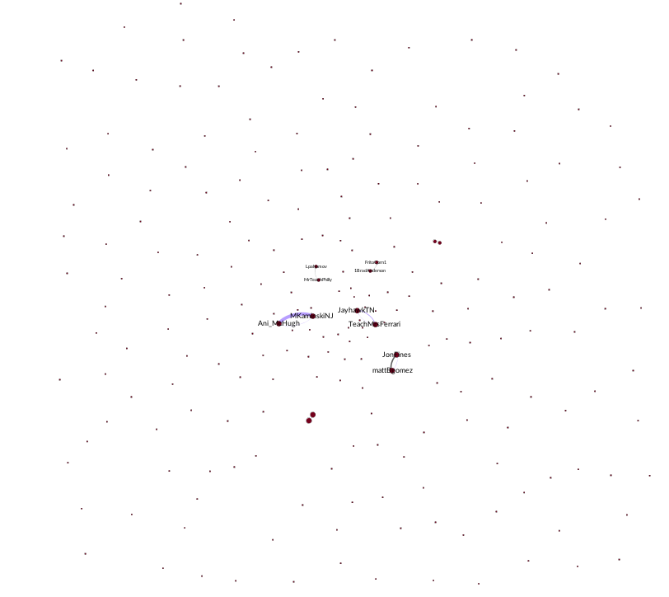
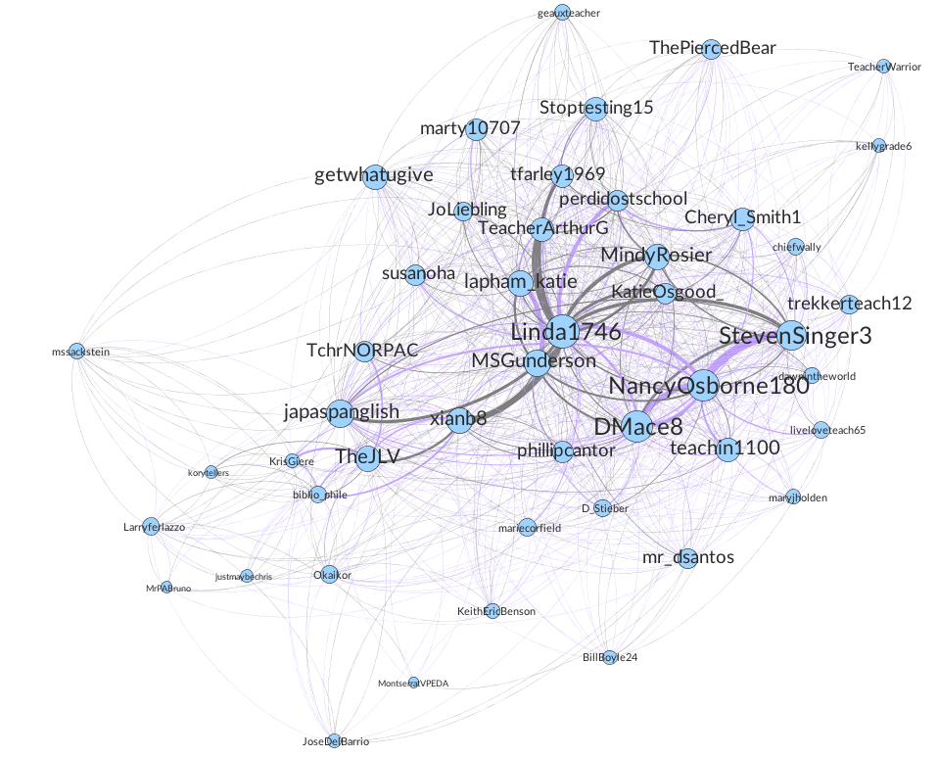
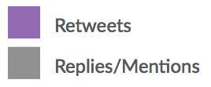
Cluster 3
Cluster 0
Notes:
DORIS Cluster 3 is a tight crowd. Tight crowds tend to be groups of likeminded individuals. Heavy twitter use, lots of dialogue, you can see that they’re both tweeting at each other, about each other and re-tweeting each other’s content. [OUR PROVISIONAL NAMES]
Cluster 0 is a pretty disconnected group with a few individuals who are very connected.

Slide 16
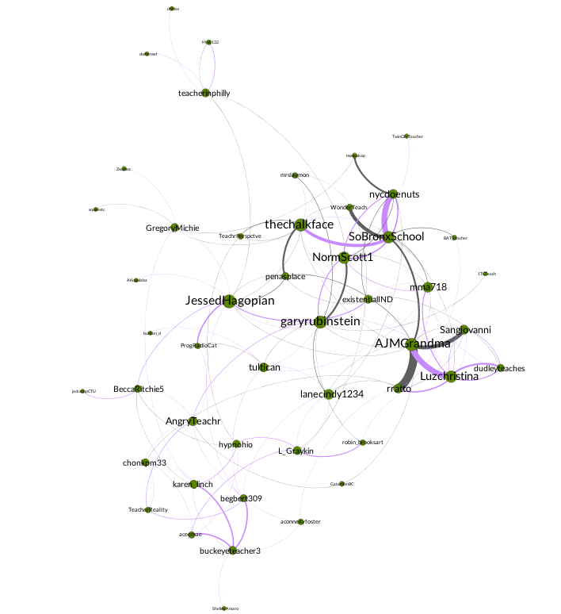
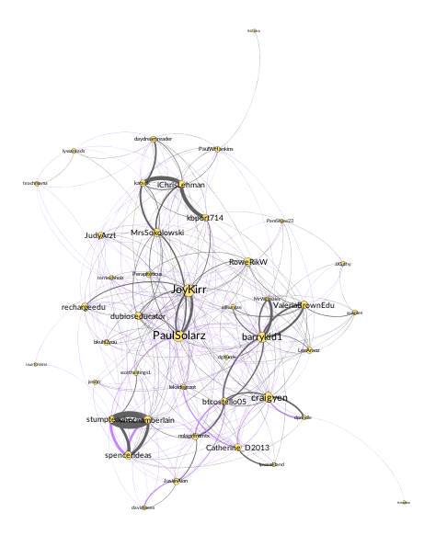
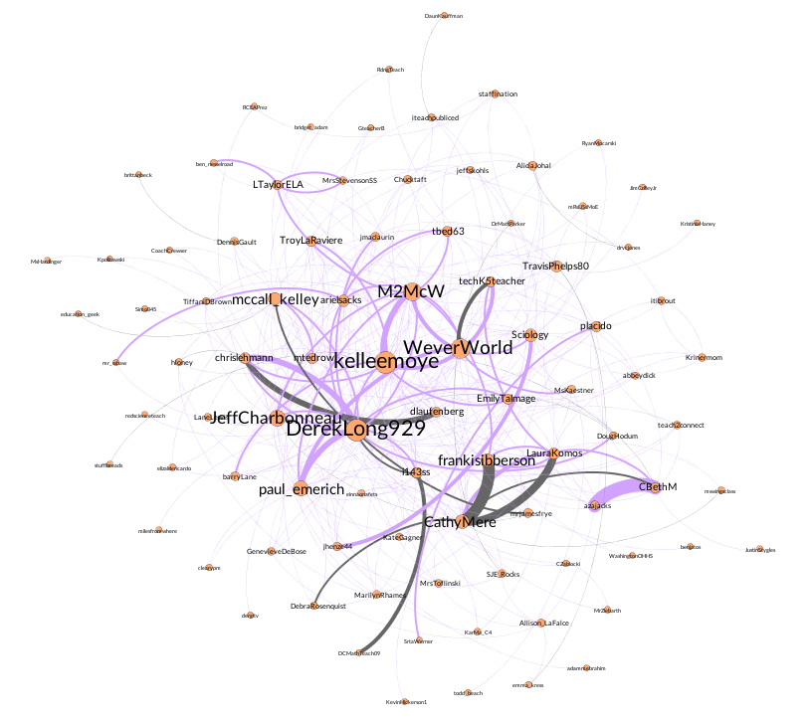
Cluster 1 Cluster 2
Cluster 4
Notes:
DORIS: These are distinct moral communities with different stakes in the issues related to the teaching field. If you cross reference this with the words of influence in forming the groups, it is clear that different topics are being discussed. [something from Dewey here]. While AI helps us understand the differences between groups, as philosophers we also want to think about the connections. So looking for points of connection is something that we can explore looking at the entire network. [PROVISIONAL NAMES]

Slide 17
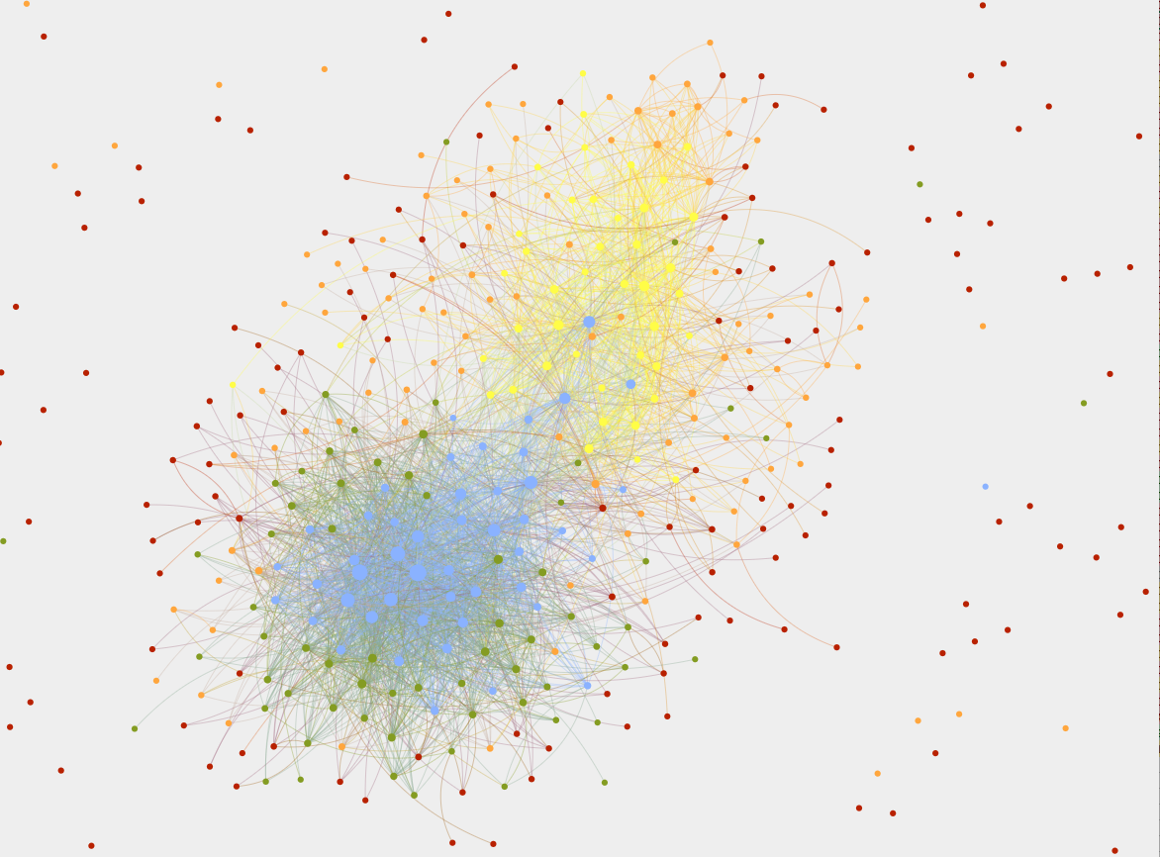
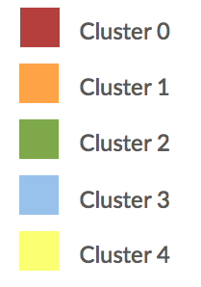
Notes:
JLH: Full network: this network is a polarized crowd, which is two groups having a conversation about the same issue in very different ways.
However, you can see that there are some bridge accounts, especially from the blue group, our largest cluster.
Two major clusters around the moral words, each using different terms most frequently. We think this is a polarized crowd, with two distinct groups. The green group also seems to be circling the blue group.

Slide 18

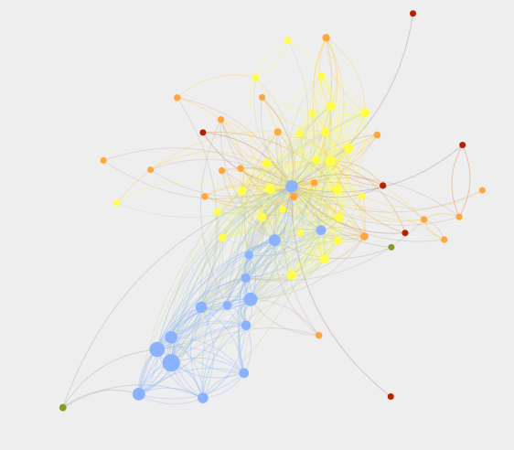
mssackstein
Notes:
JLH Bridges have infrastructure behind them, have public roles in these organizations. This blue person is a bridge between blue and yellow conversations. And, in a polarized network, where transformation is looms, it is likely that these bridges, these individuals with weak ties, will enable communication across groups and be leaders/facilitators in the transformation. The bridges also demonstrate that this conversation is transforming as blue group members reach out.
[ this network is MSSACKSTEIN]

Slide 19
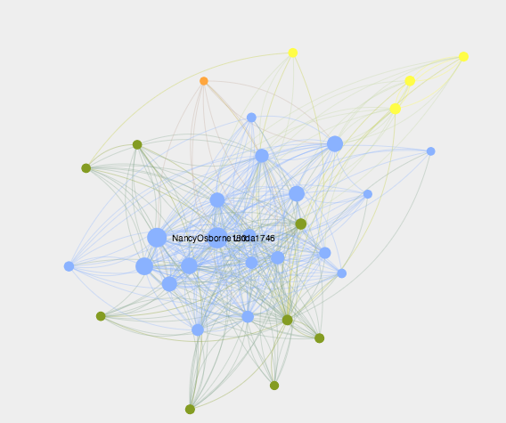
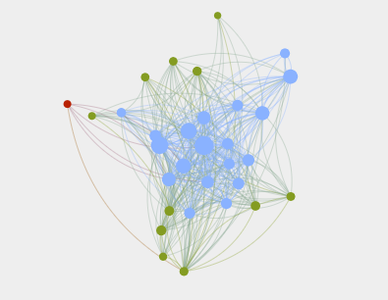
lanecindy1234
garyrubenstein
Notes:
JLH We found that the green nodes tend to have a lot of blue connections, more than to other greens, in fact. This finding pushes back the concern that social networks are echo chambers driven by homophily. At first, we thought the green nodes were tweeters-in-training, but as we looked more deeply at the network, at the relationships they have particularly with the blue nodes, we realized that many of them may merely tweet less than their blue counterparts. Garyrubenstein & lanecindy

Slide 20
Limitations, Challenges, Critiques
Twitter Research
What incentives do people have to go outside their groups? (Dodds, Muhamad, & Watts 2003)
Is tweeting “slacktivism”? (Lutz, Hoffman, & Meckel, 2014)
How can tweeters avoid the echo chamber effect? (Bakshy, Messing, & Adamic 2015)
#teachertweets
We chose the words of interest.
Lack of tweet context.
Deweyan Lens Limitation: may not have a robust account of how absence is significant.
Notes:
JLH:

Slide 21
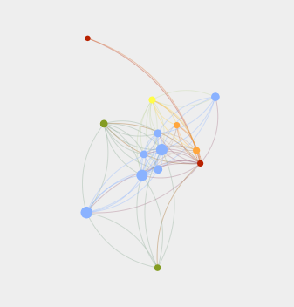
Conclusions
Teachers are creating democratic communities on Twitter.
They are talking about their work and what it means to them.
They are using moral language.
Notes:
DORIS
Teachers’ participation on Twitter can be read as an intervention on the social conditions that teachers in the U.S. face today: isolation, moral blame, deskilling; their work on Twitter intervenes upon these conditions and attempts to alter them – perhaps not changing the beliefs of those who denigrate and control them, but finding community through a demonstration of shared competence, inquiry and a space for moral expression.
Limitation of Dewey: How is absence a form of influence? What might be the implication of groups that don’t talk about something . . . Implication of communication, community, democracy.

Slide 22
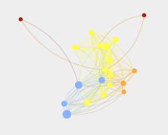
Next steps
Thinking more deeply about our methods.
Different forms of discourse analysis through AI and human coding.
Targeted network analysis to better understand flow of information.
“Deep dive” into this data through reading targeted groups of tweets and qualitative coding.

Slide 23
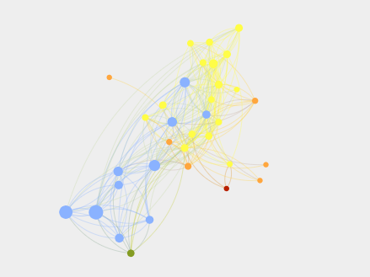
#teachertweets
Special Thanks:
Katharine Atwood, Parsons School of Design
Sergio Gomez, Bowdoin College
Crystal Hall, Bowdoin College
Contact us:
@JessicaHochman
@DorisASantoro
@TeacherTweetsPI
Image credits: Dewey image: toptenz.net; Twitter icon from Google Play Android twitter app.

